Slide 1

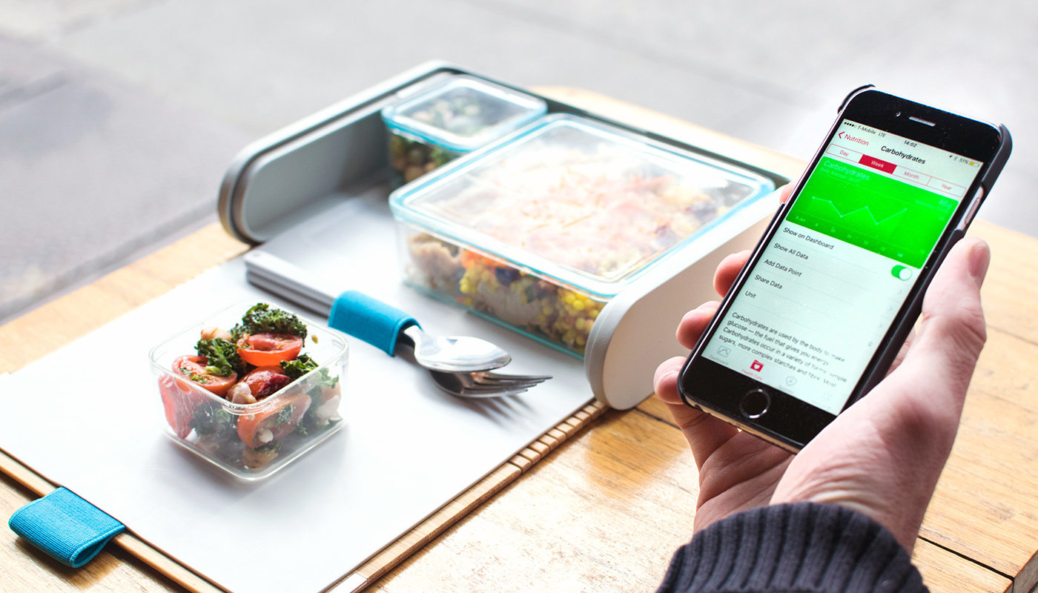
SMART LUNCH BOX
CS 890EP - Internet of Things
Supervised by Submitted by
Dr. Maher Elshakankiri Sai Keerthi Mettu
200416252
SMJ102@uregina.ca

Slide 2
What does this Smart Lunch have?
Weight the food in sections
Calorie calculator
Automatic Heating Control
Alarm signalling
Touch Authentication
Empty Box Notification

Slide 3

How does Calorie calculator work?
Weight calculated in the weighing module, is the source to identify the food calories.
Food weights are posted from the local client device to the server.
A predetermined database is made with the nutritional values of the all food varieties.
Check the inputs and standard data to calculate and produce the outputs to user.

Slide 4
Things needed to build Calorie Calculator
Hardware Components:
Arduino Uno board
NodeMCU (Wi-Fi module)
USB cables
Software Requirements:
Arduino IDE
PHP editor
Apache server
MyPhpAdmin DB
Jumper wires

Slide 5
Key development steps of Calorie Calculator
Communicate Arduino program with NodeMCU through serial connection -JSON
Integrate Wifi Module with local client
Connection from local host to web server
Processing the weights received in required format
Transfer data between the web server pages
Connect the web server with database
Process the inputs against standards to get resultants
Receive weight from Arduino Program Dynamically

Slide 6
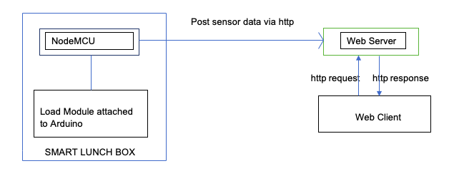
Block Diagram of Calorie Calculator

Slide 7
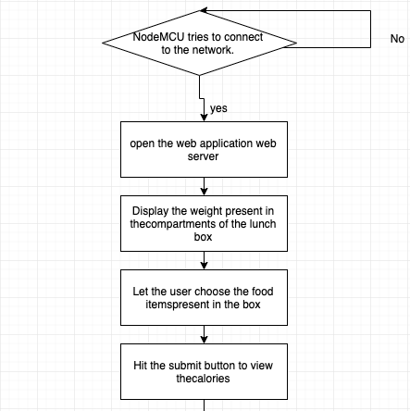
Detailed construction steps of Calorie Calculator
Contd.

Slide 8
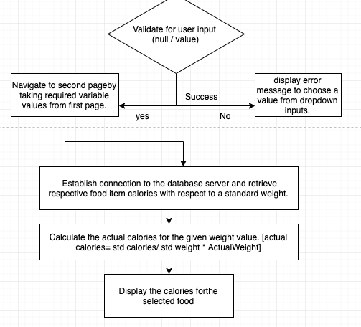
Detailed construction steps of Calorie Calculator

Slide 9
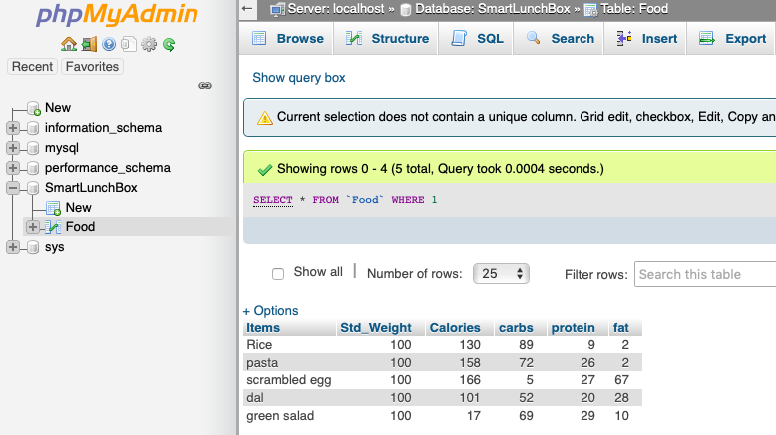
What does Smart Lunch Box database contain?

Slide 10
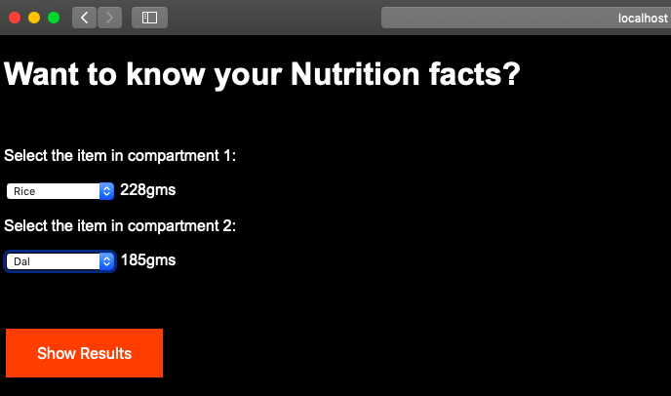
How does the calorie calculator look?
Contd.

Slide 11
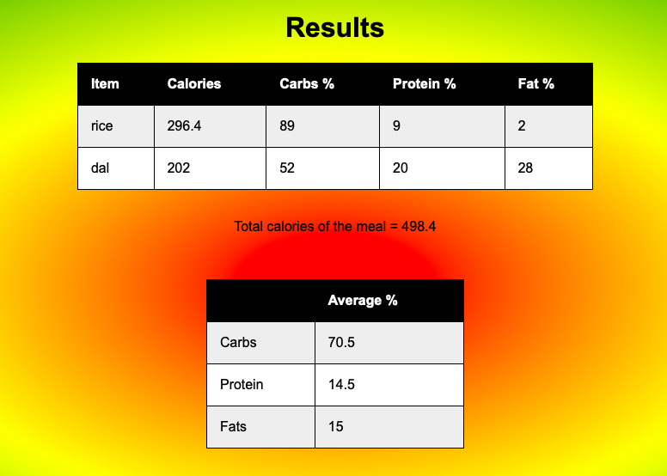
How does the calorie calculator look?

Slide 12
Alarm signaling module
A buzzer will be included inside the lunch box
Notifies the user about the lunch time
Buzzer rings according to the programmed set time interval
Can be turned off by a push button
An Alarm can also be set for cleaning the box

Slide 13
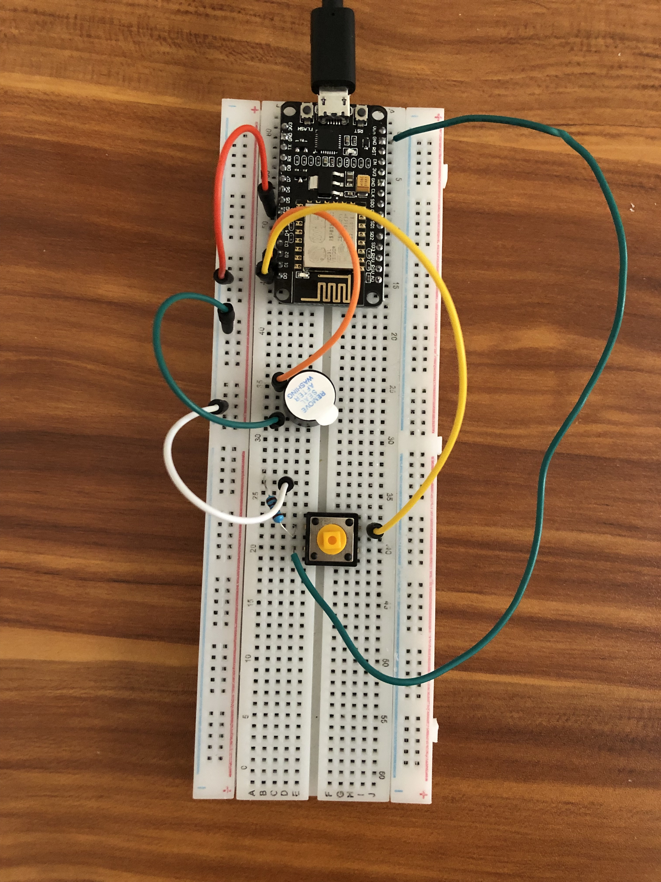
Connections of Alarm Module
Components
NodeMCU
Buzzer
Push Button
Resistor 200ohms
Jumper wires
Bread Board

Slide 14
Summary
This Smart Lunch Box, lets the user be conscious on their food intake by automatically measuring the food weight and doing the calories calculating for the food present in the compartmentalized smart box.
Automatic heating and Alarm signaling helps the users to enjoy the warm food on the right time.
Touch authentication and empty box notification would be more useful for the parents having small kids to keep a track on their food intake.
On a whole, this Smart lunch Box assists its users to manage a balanced diet and keeps track of the food consumption with all its customizable smart features with respect to the user’s need.

Slide 15
Thank you ☺

